Slide 1

”Say it Loud: James Brown, Nina Simone and the Sound of Black Consciousness

Slide 2
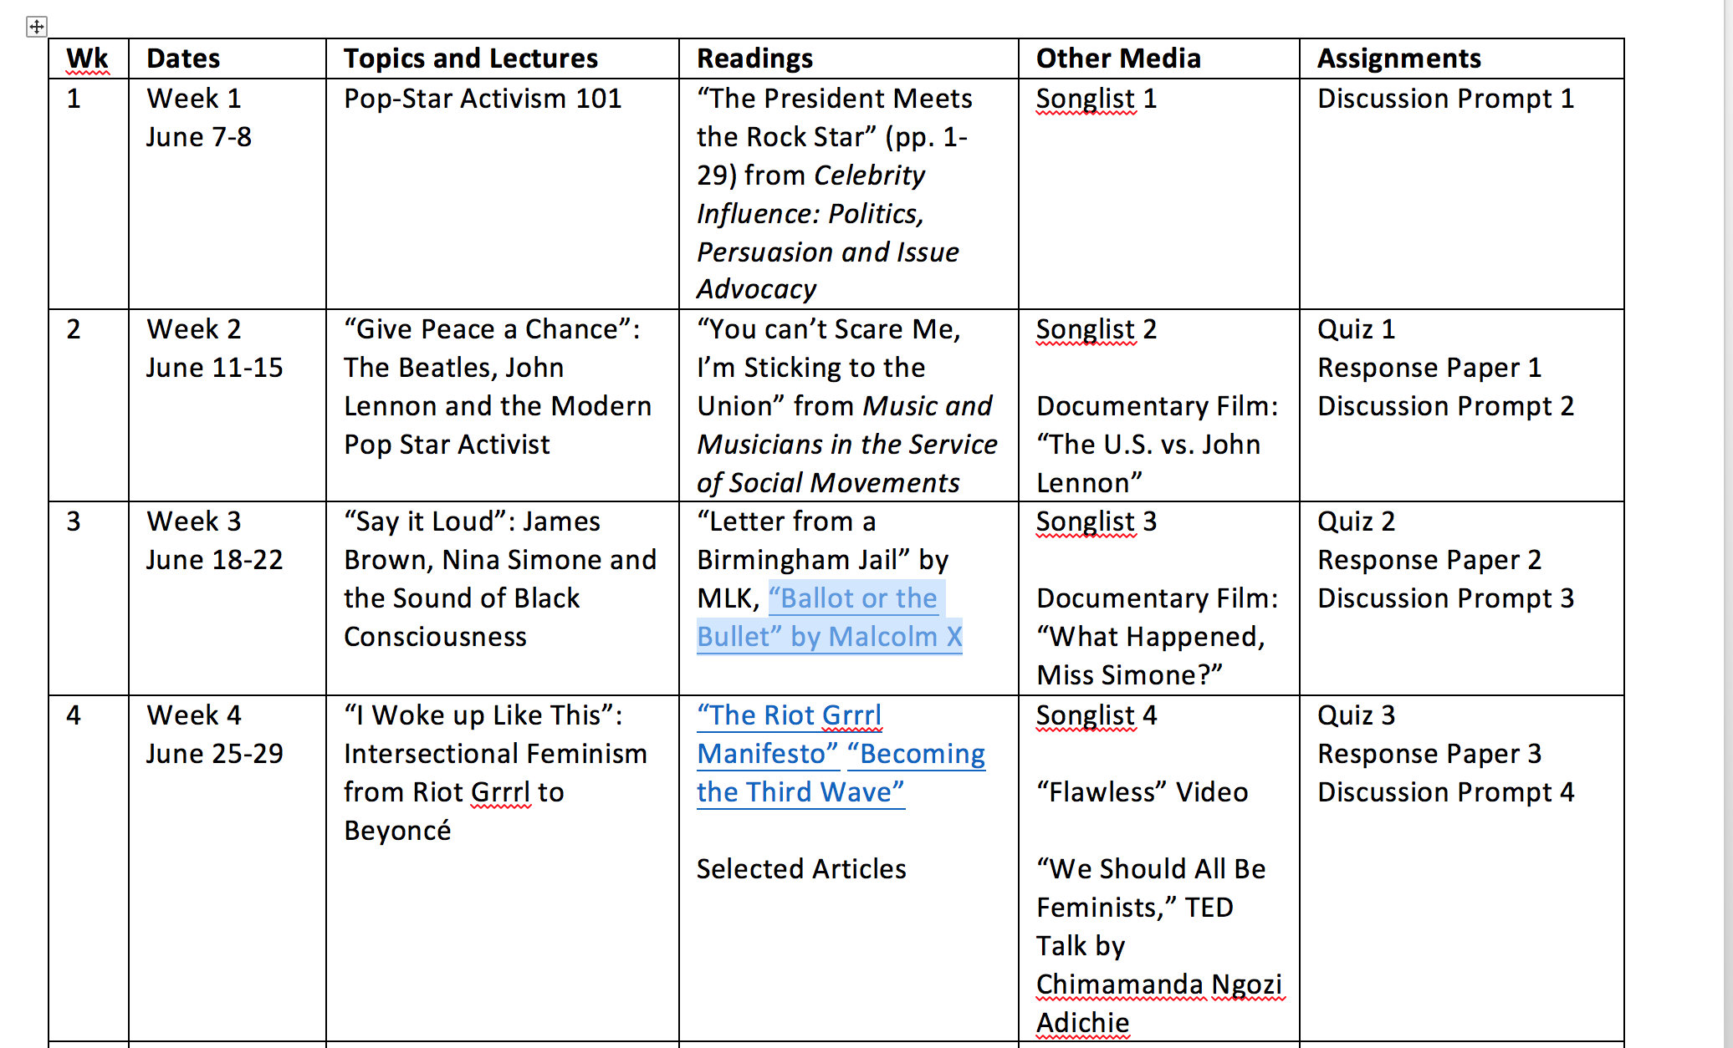
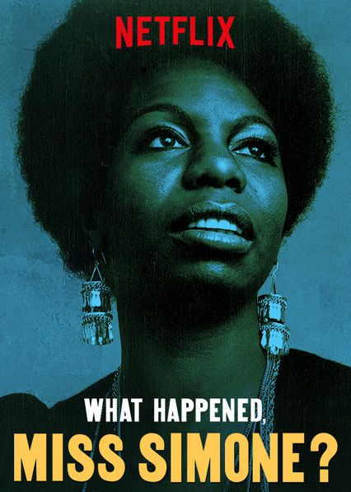
Week 3

Slide 3
Music and the Movement
“She was proclaimed the voice of the movement not by Martin Luther King but by Stokely Carmichael and H. Rap Brown, whose Black Power philosophy answered to her own experience and inclinations. As the sixties progressed, the feelings she displayed—pain, lacerating anger, the desire to burn down whole cities in revenge—made her seem at times emotionally disturbed and at other times simply the most honest black woman in America.” – Claudia Roth Pierpont, “A Raised Voice: How Nina Simone Turned the Movement into Music,” New Yorker magazine, Aug. 11, 2014.

Slide 4
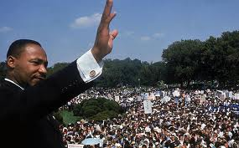
Two Approaches: Moderate and Militant
Moderate approach embodied in Martin Luther King Jr.
“Letter from a Birmingham Jail”
Militant approach embodies in Malcolm X
”Ballot or the Bullet” speech

Slide 5
Goals and Strategy of King and SCLC
Goal: desegregation of institutions and public life (and later economic justice)
Strategy: public pressure and media exposure via strategic acts of
nonviolent resistance
Tactics: boycotts, protests, demonstrations, sit-ins, marches, speeches, letters, lobbying, litigation

Slide 6
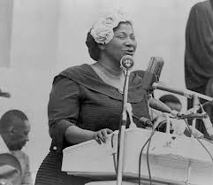
Music and the Civil Rights Movement
Bob Dylan, Joan Baez, Mahalia Jackson, and Peter, Paul and Mary performed at the March on Washington in 1963.
Video: “How I Got Over,” Mahalia Jackson

Slide 7
Music and Collective Destiny
The spirituals were revived as a tradition that symbolized a shared history of struggle and expressed a desire for freedom. They were religious songs of enduring faith and allegories of revolutionary change.
“Go Down, Moses”
When Israel was in Egypt land
Let my people go!
Oppressed so hard they could not stand
Let my people go!
So the god seyeth: 'go down, Moses
Way down in Egypt land
Tell all pharaohs to
Let my people go!'

Slide 8
Expressive Framework of Early Civil Rights Movement
  Social movements are based on ability to move people to act based on shared attitudes
    Shared identity or common feeling
    Feeling of collective fate
  Expressive Framework of Civil Rights Movement
  Themes and Messages: Freedom and deliverance, equality and justice (clear moral choices)
  Rhetoric: Old Testament narratives; biblical language, imagery and motifs; i.e., gospel music
  Authority: logic of American creed, ethos of divine justice

Slide 9
Letter From a Birmingham Jail
Justification for “nonviolent direct action”
when justice is denied and negotiation delayed
Strategic basis for identity-based
social movements from 60s--present

Slide 10
Campaign
Organized effort to achieve a goal
Goal of Birmingham Campaign – desegregate public schools, downtown business, municipal government
Strategy – force negotiations/accommodation via public pressure
Tactics – sit-ins, boycotts, marches

Slide 11
Social Movement Strategy
Basis in injustice done to group—inviolability of universal human dignity
Argument for justice—group has been wronged (evidence/authority of experience), precedence of courts (1954 Brown decision)
Argument for strategy—precedent for disobeying unjust laws
Authority—Western philosophy, theology, Biblical scripture
“Creative tension” -- precondition of change, enlightenment

Slide 12
A Message to White Moderates
King’s moderates: Those who sympathize with plight but express reservations about strategies and tactics.
“Negro’s great stumbling block in the stride toward freedom is not the White citizens’ “Councilor” or the Ku Klux Klanner, but the white moderate who is more devoted to “order” than to justice; who prefers a negative peace which is the absence of tension to a positive peace which is the presence of justice.”

Slide 13
“A Change is Gonna Come”
1963 song by Sam Cooke
Example of pop star activism emblematic of moderate approach. Song’s politics were implicit enough not to imperil commercial prospects. #9 on R&B charts, #31 on Billboard 100
“I go to the movie and I go downtown
somebody keep telling me don't hang around
It's been a long, a long time coming
But I know a change gonna come, oh yes it will”

Slide 14
Contrast: “Mississippi Goddam” by Nina Simone
Response to the Birmingham church bombings and assasination of civil rights leader Medgar Evers. Song of acerbic rage performed in the guise of a playful show tune. Not released as a single. Performed at Carnegie Hall in 1964 and the Selma March.
Full Lyrics
“Don't tell me I tell you
Me and my people just about due
I've been there so I know
They keep on saying "Go slow!"
But that's just the trouble
‘do it slow’"

Slide 15

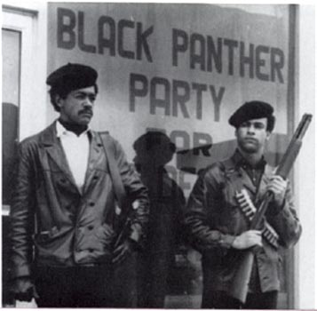
Malcolm X and Black Power
Term for variety of attitudes, strategies, goals
  More confrontational
  Distrustful of integration as a goal
  Disillusioned with nonviolence as tactic
  Distrustful of white good will
  Emphasis on black consciousness and Africa and African diaspora as source of identity
  Idea of self-determination in cultural terms and economic terms

Slide 16
Soul Music and Black Power
Music reflects aspects of black power
Emphasis is on self-assertion, self-determination and positive self-concept
Musically more free, less concerned with commercial demands

Slide 17
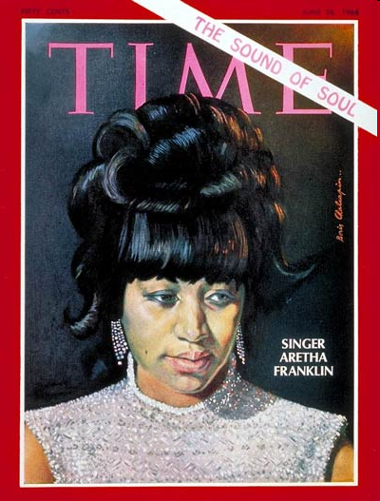
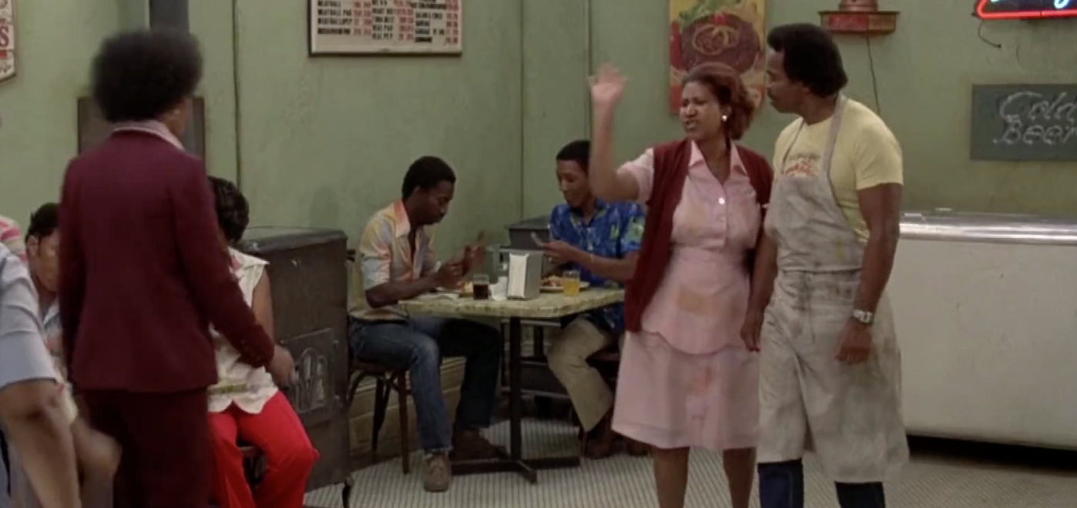
On the cover of Time, 1968
“Think”
No.1 R&B
No. 7 Hot 100
No. 1 on R&B
No. 2 Hot 100

Slide 18
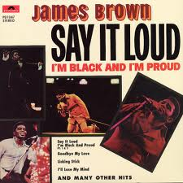
“Say it Loud (I’m Black and I’m Proud” (1968)
No. 1 R&B, No. 10 Hot 100
Full Lyrics
“Now we's demands a chance to do things for ourselves
We're tired of beating our heads against the wall
And working for someone else, hu
Now we're our people, too
We're like the birds and the bees,
But we'd rather die on our feet,
Than keep a'living on our knees”

Slide 19
Larger Framework of America and Group Identity
Melting Pot Metaphor: process of assimilation where group differences melt into the existing broth
Salad Bowl: process of cultural pluralism where group differences mix and recombine without losing their basic properties

Slide 20
Group Identity
Group Identity vs. Individual Identity
Individuals are oppressed by virtue of their membership in a particular social group—that is, a collective whose members have relatively little mobility into or out of the collective, who usually experience their membership as involuntary, who are generally identified as members by others, and whose opportunities are deeply shaped by the relation of their group to corollary groups through privilege and oppression. Oppression, then, is the systematic limiting of opportunity or constraints on self-determination because of such membership
(Stanford Encyclopedia of Philosophy; Cudd 2006).

Slide 21
Group Identities
Race—shared physical traits
Ethnicity—often used interchangeably with race, but refers to cultural traits such as language and religion
Nationality—often used interchangeably with race and ethnicity but refers to country of origin or citizenship
Sex—biological categories male and female
Gender—traits and behaviors associated with sex categories
Sexual orientation—object of sexual and romantic attraction
Transgender and gender non-binary—gender expression inconsistent with social norms for sex assigned at birth

